Slide 1
Software Testing Techniques
Trình bày: Nam Hau

Slide 2
Content
Black-Box test strategy
  Random testing
  Equivalence class partitioning
  Boundary value analysis
White-Box test strategy
  Path testing
  Control structure testing
    Control-Flow testing
    Data-Flow testing
    Loop testing
Software Testing - SE-UIT

Slide 3
White-Box test strategy
The goal for white box testing is to ensure that the internal components of a program are working properly
A common focus is on structural elements
  Statements
  Branches
The tester develops test cases that exercise these structural elements to determine if defects exist in the program structure
Software Testing - SE-UIT

Slide 4
Test adequacy criteria
Testers need a framework for
  For deciding which structural elements to select as the focus of testing
  For choosing the appropriate test data
  For deciding when the testing efforts are adequate enough to terminate the process with confidence that the software is working properly
Such a framework exists in the form of test adequacy criteria
Software Testing - SE-UIT

Slide 5
Test adequacy criteria
Formally a test data adequacy criterion is a stopping rule
  Is minimal standards for testing a program
Usually expressed as statements that depict the property, or feature of interest, and the conditions under which testing can be stopped (the criterion is satisfied)
Software Testing - SE-UIT

Slide 6
Test adequacy criteria
A program is said to be adequately tested with respect to a given criterion if
  All of the target structural elements have been exercised according to the selected criterion
Software Testing - SE-UIT

Slide 7
Types of test adequacy criteria
Program-based adequacy criterion
  Focuses on the structural properties
    Logic and control structures
    Data flow
    Program text
    Faults
Specification-based test data adequacy criteria
  Focuses on program specifications
Random selection criterion
Software Testing - SE-UIT

Slide 8
Test adequacy criteria (summary)
Helping testers to select properties of a program to focus on during test
Helping testers to select a test data set for a program based on the selected properties
Supporting testers with the development of quantitative objectives for testing
Indicating to testers whether or not testing can be stopped for that program
Software Testing - SE-UIT

Slide 9
Coverage analysis
The concept of test data adequacy criteria, and the requirement that certain features or properties of the code are to be exercised by test cases
Is used to set testing goals and to develop and evaluate test data
Test adequacy criteria as “coverage criteria”
Software Testing - SE-UIT

Slide 10
Degree of coverage
When a coverage-related testing goal is expressed as a percent
  Example: a goal for a unit specifying that the tests should be statement adequate
    A requirement for complete, or 100%, statement coverage
    Test cases developed must insure that all the statements in the unit are executed at least once
The planned degree of coverage is usually specified as 100%
Software Testing - SE-UIT

Slide 11
Degree of coverage
Under some circumstances, the planned degree of coverage may be less than 100%
  The nature of the unit
    Some statements/branches may not be reachable
    The unit may be simple, and not mission, or safety, critical, and so complete coverage is thought to be unnecessary
  The lack of resources
    The time set aside for testing is not adequate to achieve 100% coverage
    There are not enough trained testers to achieve complete coverage for all of the units
    There is a lack of tools to support complete coverage
  Other project-related issues such as timing, scheduling, and marketing constraints
Software Testing - SE-UIT

Slide 12
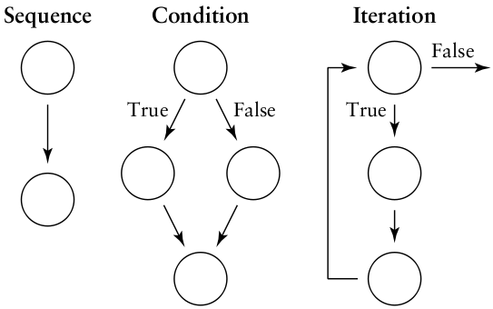
Basic program primes
Sequential
  Assignment statements
Decision
  If/then/else statements
Iterative
  While, for loops
Software Testing - SE-UIT

Slide 13
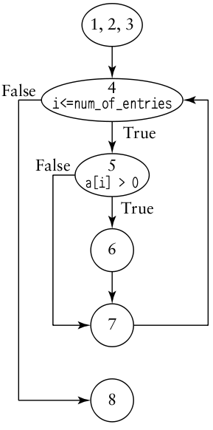
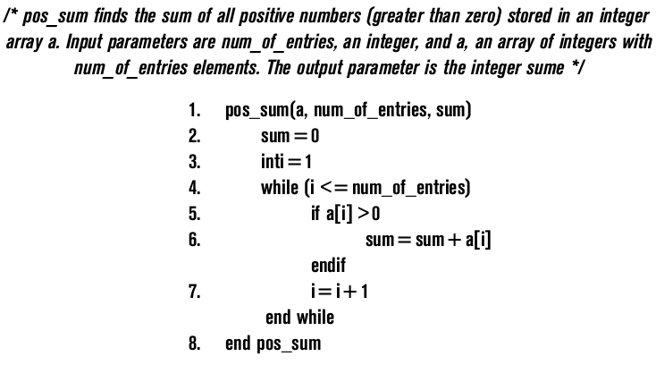
Covering code logic
Software Testing - SE-UIT

Slide 14
Covering code logic
In terms of a flow graph model of the code, satisfying this criterion requires that all the nodes in the graph are exercised at least once by the test cases
  statement adequacy criterion
In terms of the control flow model, this requires that all the edges in the corresponding flow graph must be exercised at least once
  decision (branch) adequacy criterion
Software Testing - SE-UIT

Slide 15
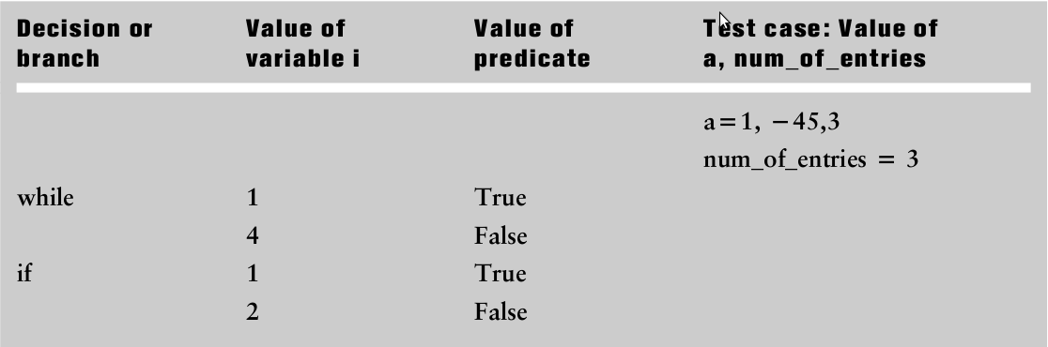
Covering code logic (example)
Software Testing - SE-UIT

Slide 16
Covering code logic
Complete decision coverage is considered to be a stronger coverage goal than statement coverage since its satisfaction results in satisfying statement coverage as well
  covering all the edges in a flow graph will ensure coverage of the nodes
Software Testing - SE-UIT

Slide 17
Covering code logic
Example:
  If (x < MIN and y > MAX and (not INT Z))
All of the coverage criterion described so far can be arranged in a hierarchy of strengths from weakest to strongest as follows:
  Statement
  Decision
  Decision/condition
Software Testing - SE-UIT

Slide 18
Covering code logic (conclusion)
In most cases the stronger the coverage criterion, the larger the number of test cases that must be developed to insure complete coverage.
The tester must decide, based on the type of code, reliability requirements, and resources available which criterion to select, since the stronger the criterion selected the more resources are usually required to satisfy it
Software Testing - SE-UIT

Slide 19
Path testing
Software Testing - SE-UIT

Slide 20
Cyclomatic Complexity
McCabe’s Cyclomatic Complexity V(G) from a flow graph
  V(G) = E – N + 2
  E is the number of edges in the control flow graph
  N is the number of nodes in the control flow graph
It is used to provide an approximation of the number of test cases needed for branch coverage in a module of structured code
Software Testing - SE-UIT

Slide 21
Path
A path is a sequence of control flow nodes usually beginning from the entry node of a graph through to the exit node
A path may go through a given segment of the control flow graph one or more times
Software Testing - SE-UIT

Slide 22
Independent path
Cyclomatic complexity is a measure of the number of so-called “independent” paths in the graph
An independent path is a special kind of path in the flow graph
The independent paths are defined as any new path through the graph that introduces a new edge that has not be traversed before the path is defined
A set of independent path supports a tester in identifying the control flow features in the code and in setting coverage goals
Software Testing - SE-UIT

Slide 23
Identify a set of independent path
Starting out with one simple path in the flow graph
Iteratively adding new paths to the set by adding new edges at each iteration until there are no more new edges to add
A set of independent paths for a graph is sometimes called a basis set
Software Testing - SE-UIT

Slide 24
Example
V(G) = 7 – 6 + 2 = 3
1-2-3-4-8
1-2-3-4-5-6-7-4-8
1-2-3-4-5-7-4-8
Software Testing - SE-UIT

Slide 25
Conclusion
The number of independent paths in a basis set is equal to the cyclomatic complexity of the graph
The cyclomatic complexity for a flow graph also gives us an approximation (usually an upper limit) of the number of tests needed to achieve branch (decision) coverage
Software Testing - SE-UIT

Slide 26
Conclusion
If we prepare white box test cases so that the inputs cause the execution of all of these paths, we can be reasonably sure that we have achieved complete statement and decision coverage for the module
In some cases the number of independent paths in the basis set can lead to an overapproximation of the number of test cases needed for decision (branch) coverage
Software Testing - SE-UIT

Slide 27
Conclusion
The basis set is a special set of paths and does not represent all the paths in a module
The basis set serves as a tool to aid the tester in achieving decision coverage
Software Testing - SE-UIT

Slide 28
Data flow testing
Software Testing - SE-UIT

Slide 29
Basic concepts – role of variables
We say a variable is defined (def) in a statement when its value is assigned or changed
  Y = 26 * X
  Read (Y)
Software Testing - SE-UIT

Slide 30
Basic concepts – role of variables
We say a variable is used in a statement when its value is utilized in a statement. The value of the variable is not changed
  A predicate use (p-use) for a variable that indicates its role in a predicate
    if (X > 98) Y = max
  A computational use (c-use) indicates the variable’s role as a part of a computation
    Y = 26 * X
Software Testing - SE-UIT

Slide 31
Data flow testing
An analysis of data flow patterns for specific variables is often very useful for defect detection
For example, use of a variable without a definition occurring first indicates a defect in the code. The variable has not been initialized
Software Testing - SE-UIT

Slide 32
Data-flow based test adequacy criteria
There are several data-flow based test adequacy criteria that map to corresponding coverage goals
  All def
  All p-uses
  All c-uses/some p-uses
  All p-uses/some c-uses
  All uses
  All def-use paths
    We say a path from a variable definition to a use is called a def-use path
Software Testing - SE-UIT

Slide 33
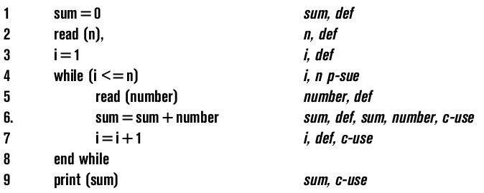
Example
To satisfy the all def-use criterion the tester must identify and classify occurrences of all the variables in the software under test
Software Testing - SE-UIT

Slide 34
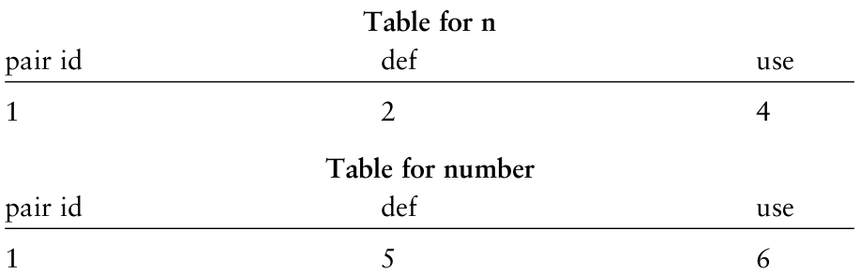
Example - tabulate
Software Testing - SE-UIT

Slide 35
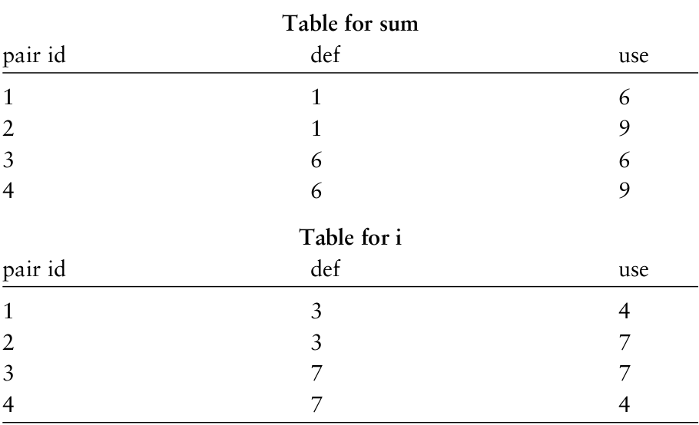
Example - tabulate
Software Testing - SE-UIT

Slide 36
Example – test set
Test data set 1: n = 0
Test data set 2: n = 5, number = 1, 2, 3, 4, 5
Software Testing - SE-UIT

Slide 37
Conclusion
As with most white box testing methods, the data flow approach is most effective at the unit level of testing
When code becomes more complex and there are more variables to consider it becomes more time consuming for the tester to analyze data flow roles, identify paths, and design the tests
Other problems with data flow oriented testing occur in the handling of dynamically bound variables such as pointers
No commercially available tools
Software Testing - SE-UIT

Slide 38
Loop testing
Software Testing - SE-UIT

Slide 39
Category of loop
Beizer has classified loops into four categories
  Simple
  Nested
  Concatenated
  Unstructured
Software Testing - SE-UIT

Slide 40
Simple loop
In a simple loop that can have a range of zero to n iterations, test cases should be developed so that there are
  zero iterations of the loop, i.e., the loop is skipped in its entirely;
  one iteration of the loop
  two iterations of the loop
  k iterations of the loop where k < n
  N – 1‬ iterations of the loop
  N + 1 ‬iterations of the loop (if possible)
If the loop has a nonzero minimum number of iterations, try one less than the minimum
Software Testing - SE-UIT

Slide 41
Nested loop
Beizer has some suggestions for testing nested loops where
  the outer loop control variables are set to minimum values and the innermost loop is exercised as above
  The tester then moves up one loop level and finally tests all the loops simultaneously
This will limit the number of tests to perform
Software Testing - SE-UIT

